Slide 1
Solving complex linear equations involving brackets
Solving linear equations

Slide 2
how to use Oak lessons

Slide 3
I can solve equations involving brackets where simplification is necessary first.

Slide 4
An equation is used to show two expressions that are equal to each other.

Slide 5

Solving complex linear equations involving brackets
Solving equations with multiple sets of brackets
Simplifying before solving

Slide 6
Solving equations with multiple sets of brackets
Sometimes we need to work with equations with multiple sets of brackets.
For example, the perimeter of this rectangle is 33 cm. Find x
2(2x + 3) + 2(9 − x) | = | 33
4x + 6 + 18 − 2x | = | 33
2x + 24 | = | 33
2(2x + 3) + 2(9 − x) | = | 33
2(2x + 3) + 2(9 − x) | = | 33
4x + 6 + 18 − 2x | = | 33
9 − x
2x + 3
After expanding the brackets we’ll have an expression that has like terms that can be simplified.

Slide 7
Solving equations with multiple sets of brackets
Sometimes we need to work with equations with multiple sets of brackets.
For example, the perimeter of this rectangle is 33 cm. Find x
2(2x + 3) + 2(9 − x) | = | 33
4x + 6 + 18 − 2x | = | 33
2x + 24 | = | 33
2(2x + 3) + 2(9 − x) | = | 33
4x + 6 + 18 − 2x | = | 33
2x + 24 | = | 33
2x | = | 9
x | = | 4.5
9 − x
2x + 3
This is now in the form ax + b = c which we can be solved.

Slide 8
Solving equations with multiple sets of brackets
If we can manipulate an equation into the form ax + b = c we can easily solve.
The first step here is to expand the brackets.
3(x + 4) + 2(3x + 7) | = | 89
3x + 12 + 6x + 14 | = | 89
9x + 26 | = | 89
9x | = | 63
x | = | 7
3(x + 4) + 2(3x + 7) | = | 89
3(x + 4) + 2(3x + 7) | = | 89
3x + 12 + 6x + 14 | = | 89
3(x + 4) + 2(3x + 7) | = | 89
3x + 12 + 6x + 14 | = | 89
9x + 26 | = | 89
Now we have like terms that can be collected to simplify.
Now in the form ax + b = c we can solve.

Slide 9
Solving equations with multiple sets of brackets
Visual representations often help us to understand what is going on in mathematics.
3(x + 4) + 2(3x + 7) | = | 89
x
4
x
4
x
4
x
x
x
7
x
x
x
7
89
3x + 12 + 6x + 14 | = | 89
x
x
x
4
4
4
x
x
x
x
x
x
7
7
89

Slide 10
Solving equations with multiple sets of brackets
Visual representations often help us to understand what is going on in mathematics.
3x + 12 + 6x + 14 | = | 89
x
x
x
4
4
4
x
x
x
x
x
x
7
7
89
9x + 26 | = | 89
x
x
x
x
x
x
x
x
x
4
4
4
7
7
89

Slide 11
Solving equations with multiple sets of brackets
Visual representations often help us to understand what is going on in mathematics.
9x + 26 | = | 89
9x | = | 63
x | = | 7
63
x
x
x
x
x
x
x
x
x
4
4
4
7
7
89

Slide 12
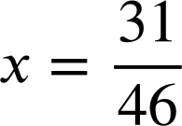
Solving equations with multiple sets of brackets
Even with brackets both sides we can manipulate the equation into the form ax + b = c to solve.
5(x − 1) + 7(2x + 4) | = | 9(6 − 3x)
5x − 5 + 14x + 28 | = | 54 − 27x
19x + 23 | = | 54 − 27x
46x + 23 | = | 54
46x | = | 31
Expand the brackets.
5(x − 1) + 7(2x + 4) | = | 9(6 − 3x)
5(x − 1) + 7(2x + 4) | = | 9(6 − 3x)
5x − 5 + 14x + 28 | = | 54 − 27x
5(x − 1) + 7(2x + 4) | = | 9(6 − 3x)
5x − 5 + 14x + 28 | = | 54 − 27x
19x + 23 | = | 54 − 27x
5(x − 1) + 7(2x + 4) | = | 9(6 − 3x)
5x − 5 + 14x + 28 | = | 54 − 27x
19x + 23 | = | 54 − 27x
46x + 23 | = | 54
Collect like terms.
Gather x terms on one side.
Now in the form ax + b = c we can solve.

Slide 13
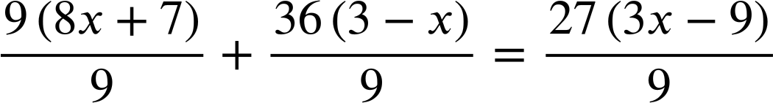

Solving equations with multiple sets of brackets
There may be circumstances in which expanding the brackets might not be your first step.
9(8x + 7) + 36(3 − x) | = | 27(3x − 9)
The multipliers 9, 27, and 36 share a common factor of 9
Multiply through by the reciprocal
(8x + 7) + 4(3 − x) | = | 3(3x − 9)
This is a more simple equation to solve.

Slide 14
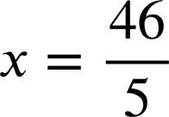
Solving equations with multiple sets of brackets
There may be circumstances in which expanding the brackets might not be your first step.
9(8x + 7) + 36(3 − x) | = | 27(3x − 9)
(8x + 7) + 4(3 − x) | = | 3(3x − 9)
8x + 7 + 12 − 4x | = | 9x − 27
4x + 19 | = | 9x − 27
46 | = | 5x
9(8x + 7) + 36(3 − x) | = | 27(3x − 9)
(8x + 7) + 4(3 − x) | = | 3(3x − 9)
9(8x + 7) + 36(3 − x) | = | 27(3x − 9)
9(8x + 7) + 36(3 − x) | = | 27(3x − 9)
(8x + 7) + 4(3 − x) | = | 3(3x − 9)
8x + 7 + 12 − 4x | = | 9x − 27
9(8x + 7) + 36(3 − x) | = | 27(3x − 9)
(8x + 7) + 4(3 − x) | = | 3(3x − 9)
8x + 7 + 12 − 4x | = | 9x − 27
4x + 19 | = | 9x − 27

Slide 15

Solving equations with multiple sets of brackets
What is the first step to solving this equation?
3(x + 4) + 5(x + 2) | = | 46
3x + 12 + 5x + 10 | = | 46
3(x + 4) + 5(x + 2) | = | 46
Expanding the brackets
We can’t collect the like terms until the brackets are expanded.
Collecting like terms
Gathering x terms on one side

Slide 16
Solving equations with multiple sets of brackets
What will the next step to solving this equation look like?
3(x + 4) + 5(x + 2) | = | 46
3x + 12 + 5x + 10 | = | 46
3(x + 4) + 5(x + 2) | = | 46
3(x + 4) + 5(x + 2) | = | 46
3x + 12 + 5x + 10 | = | 46
8x + 22 | = | 46
8x | = | 24
x | = | 3
(3 + 12)x + (5 + 10)x | = | 46
Unlike terms can not be gathered.
3x + 5x + 12 + 10 | = | 46
Useful to commute like terms but not yet simplified.
8x + 22 | = | 46
Like terms gathered and simplified.

Slide 17
Solving equations with multiple sets of brackets.
1) Fill in the blanks to complete these two equations.
2(5x + 1) + 5(x − 7) | = | 27
10x + 2 + 5x − 35 | = | 27
15x − 33 | = | 27
15x | = | 60
x | = | 4
4(2x + 6) + 7(4 − x) | = | 2(2x − 7)
8x + 24 + 28 − 7x | = | 4x − 14
x + 52 | = | 4x − 14
52 | = | 3x − 14
66 | = | 3x
x | = | 22
a)
b)

Slide 18
Solving equations with multiple sets of brackets.
2) Each solution contains an error. Identify it and write a sentence explaining why it is wrong.
2(7x + 4) + 3x | = | 88
14x + 8 + 6x | = | 88
20x + 8 | = | 88
20x | = | 80
x | = | 4
3(2y + 7) − 5(y + 1) | = | 7(3y − 2)
6y + 21 − 5y + 5 | = | 21y − 14
y + 26 | = | 21y − 14
26 | = | 20y − 14
40 | = | 20y
y | = | 2
a)
b)

Slide 19
Solving equations with multiple sets of brackets.
3) Solve:
2(7x − 3) + 4(x + 9) | = | 12
3(2x + 6) + 5(x + 1) | = | 9(x + 3)
a)
b)
4(2a + 7) | = | 12a − 6(a + 8)
3(2x − 6) − 5(x + 1) | = | 9(x + 3)
c)
d)

Slide 20
Solving equations with multiple sets of brackets.
1) Fill in the blanks to complete these two equations.
2(5x + 1) + 5(x − 7) | = | 27
10x + 2 + 5x − 35 | = | 27
15x − 33 | = | 27
15x | = | 60
x | = | 4
4(2x + 6) + 7(4 − x) | = | 2(2x − 7)
8x + 24 + 28 − 7x | = | 4x − 14
x + 52 | = | 4x − 14
52 | = | 3x − 14
66 | = | 3x
x | = | 22
a)
b)

Slide 21
Solving equations with multiple sets of brackets.
2) Each solution contains an error. Identify it and write a sentence explaining why it is wrong.
2(7x + 4) + 3x | = | 88
14x + 8 + 6x | = | 88
20x + 8 | = | 88
20x | = | 80
x | = | 4
a)
You may have written:
The terms 7x and 4 are inside the bracket so are correctly multiplied by 2 but, the term 3x sits outside the bracket on its own so should not have been multiplied.

Slide 22
Solving equations with multiple sets of brackets.
2) Each solution contains an error. Identify it and write a sentence explaining why it is wrong.
3(2y + 7) − 5(y + 1) | = | 7(3y − 2)
6y + 21 − 5y + 5 | = | 21y − 14
y + 26 | = | 21y − 14
26 | = | 20y − 14
40 | = | 20y
y | = | 2
b)
You may have written:
The second bracket was incorrectly multiplied out. It should multiply out as −5(y + 1) = −5y − 5
The term should be −5, not +5

Slide 23
Solving equations with multiple sets of brackets.
3) Solve:
2(7x − 3) + 4(x + 9) | = | 12
14x − 6 + 4x + 36 | = | 12
2(7x − 3) + 4(x + 9) | = | 12
14x − 6 + 4x + 36 | = | 12
18x + 30 | = | 12
2(7x − 3) + 4(x + 9) | = | 12
14x − 6 + 4x + 36 | = | 12
18x + 30 | = | 12
18x | = | −18
x | = | −1
2(7x − 3) + 4(x + 9) | = | 12
3(2x + 6) + 5(x + 1) | = | 9(x + 3)
3(2x + 6) + 5(x + 1) | = | 9(x + 3)
6x + 18 + 5x + 5 | = | 9x + 27
3(2x + 6) + 5(x + 1) | = | 9(x + 3)
6x + 18 + 5x + 5 | = | 9x + 27
11x + 23 | = | 9x + 27
3(2x + 6) + 5(x + 1) | = | 9(x + 3)
6x + 18 + 5x + 5 | = | 9x + 27
11x + 23 | = | 9x + 27
11x | = | 9x + 4
2x | = | 4
x | = | 2
a)
b)

Slide 24
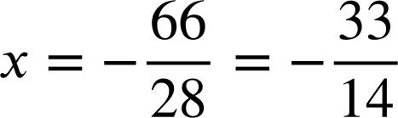
Solving equations with multiple sets of brackets.
3) Solve:
4(2a + 7) | = | 12a − 6(a + 8)
8a + 28 | = | 12a − 6a − 48
8a + 28 | = | 6a − 48
2a + 28 | = | −48
2a | = | −76
a | = | −38
4(2a + 7) | = | 12a − 6(a + 8)
8a + 28 | = | 12a − 6a − 48
8a + 28 | = | 6a − 48
2a + 28 | = | −48
4(2a + 7) | = | 12a − 6(a + 8)
8a + 28 | = | 12a − 6a − 48
4(2a + 7) | = | 12a − 6(a + 8)
8a + 28 | = | 12a − 6a − 48
8a + 28 | = | 6a − 48
4(2a + 7) | = | 12a − 6(a + 8)
7(3x − 4) + 8(2 − 5x) | = | 9(x + 6)
21x − 28 + 16 − 40x | = | 9x + 54
−19x − 12 | = | 9x + 54
−12 | = | 28x + 54
−66 | = | 28x
7(3x − 4) + 8(2 − 5x) | = | 9(x + 6)
7(3x − 4) + 8(2 − 5x) | = | 9(x + 6)
21x − 28 + 16 − 40x | = | 9x + 54
7(3x − 4) + 8(2 − 5x) | = | 9(x + 6)
21x − 28 + 16 − 40x | = | 9x + 54
−19x − 12 | = | 9x + 54
7(3x − 4) + 8(2 − 5x) | = | 9(x + 6)
21x − 28 + 16 − 40x | = | 9x + 54
−19x − 12 | = | 9x + 54
−12 | = | 28x + 54
c)
d)

Slide 25
Solving complex linear equations involving brackets
Solving equations with multiple sets of brackets
Simplifying before solving

Slide 26
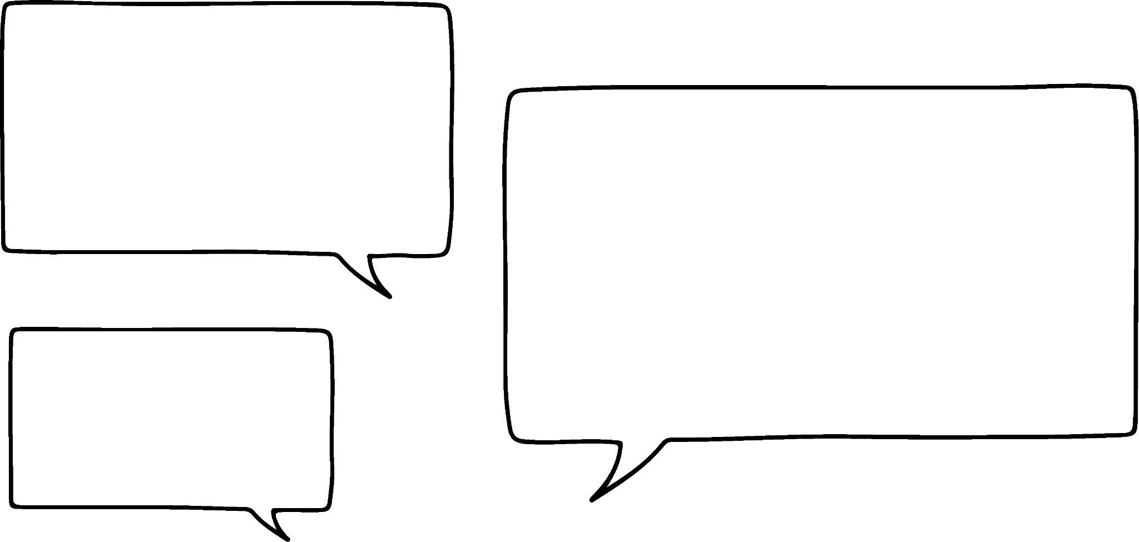


Simplifying before solving
Jacob and Jun are solving this equation.
2(x + 5) + 3(x + 5) | = | 40
2x + 10 + 3x + 15 | = | 40
5x + 25 | = | 40
5x | = | 15
x | = | 3
2(x + 5) + 3(x + 5) | = | 40
2(x + 5) + 3(x + 5) | = | 40
5(x + 5) | = | 40
2(x + 5) + 3(x + 5) | = | 40
Do you agree with Jun’s idea?
Expand first, then collect like terms.
I think I see a quicker way!

Slide 27
Simplifying before solving
Jacob and Jun are solving this equation.
2(x + 5) + 3(x + 5) | = | 40
2x + 10 + 3x + 15 | = | 40
5x + 25 | = | 40
5x | = | 15
x | = | 3
2(x + 5) + 3(x + 5) | = | 40
2(x + 5) + 3(x + 5) | = | 40
5(x + 5) | = | 40
5x + 25 | = | 40
5x | = | 15
x | = | 3
2(x + 5) + 3(x + 5) | = | 40
5(x + 5) | = | 40
2(x + 5) + 3(x + 5) | = | 40
5(x + 5) | = | 40
5x + 25 | = | 40
Jun’s method got to the same equation, same solution, more efficiently.

Slide 28
Simplifying before solving
Jacob and Jun are solving this equation.
2(x + 5) + 3(x + 5) | = | 40
The expressions in the brackets are identical so can be simplified.

Slide 29
Simplifying before solving
Jacob and Jun are solving this equation.
2(x + 5) + 3(x + 5) | = | 40
5(x + 5) | = | 40
x
5
x
5
x
5
x
5
x
5
40

Slide 30
Simplifying before solving
Jacob and Jun are solving this equation.
2(x + 5) + 3(x + 5) | = | 40
By collecting identical expressions Jun has simplified our equation which will make our solution more efficient.
5(x + 5) | = | 40
x
5
x
5
x
5
x
5
x
5
40

Slide 31
Simplifying before solving
Jacob and Jun are solving another equation.
5(x − 3) + 3(x − 3) | = | 40 − 2(x − 3)
8(x − 3) | = | 40 − 2(x − 3)
5(x − 3) + 3(x − 3) | = | 40 − 2(x − 3)
I see it! We can simplify like this before expanding.
You can simplify even further than that, Jacob.
Can you see what Jun means?

Slide 32
Simplifying before solving
Jacob and Jun are solving another equation.
5(x − 3) + 3(x − 3) | = | 40 − 2(x − 3)
8(x − 3) | = | 40 − 2(x − 3)
5(x − 3) + 3(x − 3) | = | 40 − 2(x − 3)
5(x − 3) + 3(x − 3) | = | 40 − 2(x − 3)
8(x − 3) | = | 40 − 2(x − 3)
10(x − 3) | = | 40
10x − 30 | = | 40
10x | = | 70
x | = | 7
5(x − 3) + 3(x − 3) | = | 40 − 2(x − 3)
8(x − 3) | = | 40 − 2(x − 3)
10(x − 3) | = | 40
The (x − 3) on the RHS is also identical
We could do it even more efficiently!

Slide 33
Simplifying before solving
Jacob and Jun are solving another equation.
5(x − 3) + 3(x − 3) | = | 40 − 2(x − 3)
8(x − 3) | = | 40 − 2(x − 3)
10(x − 3) | = | 40
x − 3 | = | 4
x | = | 7
5(x − 3) + 3(x − 3) | = | 40 − 2(x − 3)
8(x − 3) | = | 40 − 2(x − 3)
10(x − 3) | = | 40
5(x − 3) + 3(x − 3) | = | 40 − 2(x − 3)
8(x − 3) | = | 40 − 2(x − 3)
5(x − 3) + 3(x − 3) | = | 40 − 2(x − 3)
5(x − 3) + 3(x − 3) | = | 40 − 2(x − 3)
8(x − 3) | = | 40 − 2(x − 3)
10(x − 3) | = | 40
x − 3 | = | 4
10 is a common factor of 10 and 40

Slide 34

Simplifying before solving
Which of these equations could be simplified before solving?
Identical expressions of (x − 2)
5(x − 2) − 2(x − 2) | = | 17
3(x − 2) | = | 17
5(x − 2) + 2(x + 2) | = | 8
(x − 2) and (x + 2) are not identical expressions.
2(3x + 6) | = | 4 − 7(3x + 6)
Identical expressions of (3x + 6)
9(3x + 6) | = | 4
5(x + 2) + 4(x + 9) | = | 8 − 3(x + 2)

Slide 35
Simplifying before solving
Which of these equations could be simplified before solving?
5(x + 2) + 4(x + 9) | = | 8 − 3(x + 2)
8(x + 2) + 4(x + 9) | = | 8
(x + 2) and (x − 9) are not identical expressions but, (x + 2) and (x + 2) are.
5(x + 2) + 4(x + 9) | = | 8 − 3(x + 2)

Slide 36
Simplify before solving
1) Solve these equations twice. Firstly by expanding first, secondly by simplifying before expanding.
Write a sentence to compare the efficiency.
a)
b)
9(x + 4) + 2(x + 4) | = | 99
17 + 5(x − 3) | = | 8(x − 3) − 4(x − 3)

Slide 37
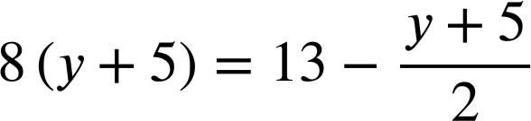
Simplify before solving
2) Solve:
a)
4x + 24 + 7(x + 6) | = | 24 + 11(x + 6)
b)

Slide 38
Simplify before solving
1) Solve these equations twice. Firstly by expanding first, secondly by simplifying before expanding.
9(x + 4) + 2(x + 4) | = | 99
9x + 36 + 2x + 8 | = | 99
11x + 44 | = | 99
11x | = | 55
x | = | 5
9(x + 4) + 2(x + 4) | = | 99
9(x + 4) + 2(x + 4) | = | 99
9x + 36 + 2x + 8 | = | 99
9(x + 4) + 2(x + 4) | = | 99
9x + 36 + 2x + 8 | = | 99
11x + 44 | = | 99
9(x + 4) + 2(x + 4) | = | 99
11(x + 4) | = | 99
x + 4 | = | 9
x | = | 5
9(x + 4) + 2(x + 4) | = | 99
9(x + 4) + 2(x + 4) | = | 99
11(x + 4) | = | 99
a)
9(x + 4) + 2(x + 4) | = | 99
11(x + 4) | = | 99
x + 4 | = | 9
You may have written:
Simplifying identical expressions was more efficient, with simpler steps.

Slide 39
Simplify before solving
1) Solve these equations twice. Firstly by expanding first, secondly by simplifying before expanding.
b)
7 + 5(x − 3) | = | 8(x − 3) − 2(x − 3)
7 + 5x − 15 | = | 8x − 24 − 2x + 6
−8 + 5x | = | 6x − 18
10 + 5x | = | 6x
x | = | 10
7 + 5(x − 3) | = | 8(x − 3) − 2(x − 3)
7 + 5x − 15 | = | 8x − 24 − 2x + 6
7 + 5(x − 3) | = | 8(x − 3) − 2(x − 3)
7 + 5(x − 3) | = | 8(x − 3) − 2(x − 3)
7 + 5x − 15 | = | 8x − 24 − 2x + 6
−8 + 5x | = | 6x − 18
7 + 5(x − 3) | = | 8(x − 3) − 2(x − 3)
7 + 5(x − 3) | = | 6(x − 3)
7 | = | x − 3
x | = | 10
7 + 5(x − 3) | = | 8(x − 3) − 2(x − 3)
7 + 5(x − 3) | = | 8(x − 3) − 2(x − 3)
7 + 5(x − 3) | = | 6(x − 3)
7 + 5(x − 3) | = | 8(x − 3) − 2(x − 3)
7 + 5(x − 3) | = | 6(x − 3)
7 | = | x − 3
You may have written:
Simplifying identical expressions was again more efficient, and also avoided a lot of manipulating negative terms.

Slide 40
Simplify before solving
2) Solve:
4x + 24 + 9(x + 6) | = | 24 + 11(x + 6)
4(x + 6) + 9(x + 6) | = | 24 + 11(x + 6)
13(x + 6) | = | 24 + 11(x + 6)
2(x + 6) | = | 24
x + 6 | = | 12
x | = | 6
4x + 24 + 9(x + 6) | = | 24 + 11(x + 6)
4(x + 6) + 9(x + 6) | = | 24 + 11(x + 6)
4x + 24 + 9(x + 6) | = | 24 + 11(x + 6)
4x + 24 + 9(x + 6) | = | 24 + 11(x + 6)
4(x + 6) + 9(x + 6) | = | 24 + 11(x + 6)
13(x + 6) | = | 24 + 11(x + 6)
a)
4x + 24 + 9(x + 6) | = | 24 + 11(x + 6)
4(x + 6) + 9(x + 6) | = | 24 + 11(x + 6)
13(x + 6) | = | 24 + 11(x + 6)
2(x + 6) | = | 24

Slide 41
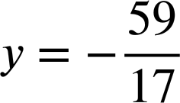
Simplify before solving
2) Solve:
b)
16(y + 5) | = | 26 − (y + 5)
17(y + 5) | = | 26
17y + 85 | = | 26
17y | = | −59
16(y + 5) | = | 26 − (y + 5)
16(y + 5) | = | 26 − (y + 5)
17(y + 5) | = | 26
16(y + 5) | = | 26 − (y + 5)
17(y + 5) | = | 26
17y + 85 | = | 26

Slide 42
Solving complex linear equations involving brackets
Equations involving brackets don’t need to be expanded as a first step if they can be simplified first.
For example, 7(y − 11) + 3(y − 11) = 18 can be simplified to 10(y − 11) = 18 before solving.

Slide 43

© Oak National Academy 2023.
Produced in partnership with Mathematics in Education and Industry.
Licensed on the Open Government Licence v3.0, except where otherwise stated. See Oak terms and conditions.

